Slide 1



Solution Qunatique
View in Power BI
Last data refresh:
9/26/2026 8:27:21 AM UTC
Downloaded at:
9/26/2026 8:30:22 AM UTC

Slide 2
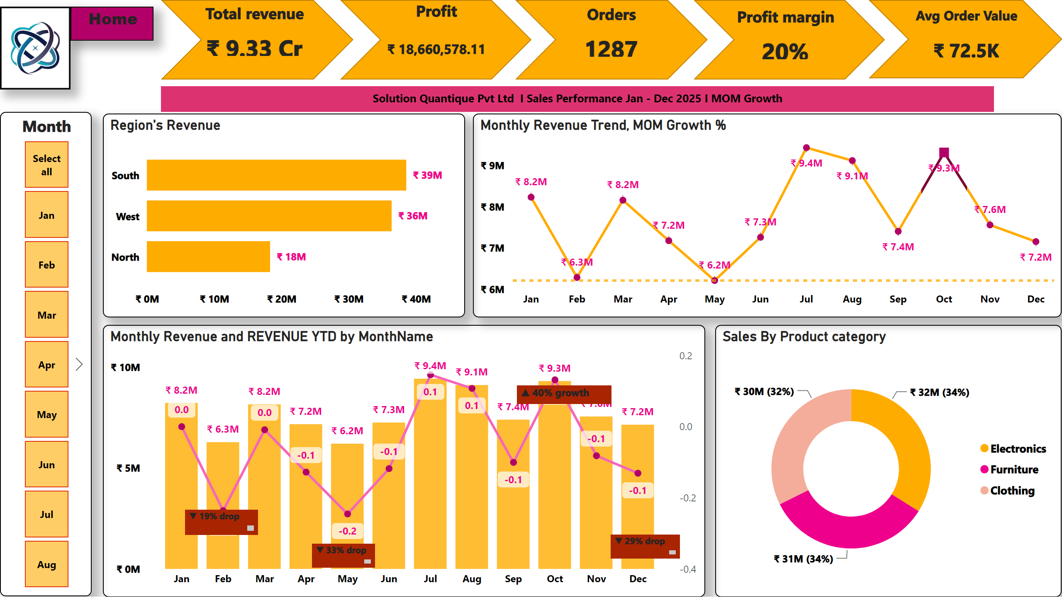
Executive Summary-SQ1
Notes:
Month
No alt text provided
Region's Revenue
No alt text provided
Monthly Revenue Trend, MOM Growth %
No alt text provided
Monthly Revenue and REVENUE YTD by MonthName
No alt text provided
Sales By Product category
No alt text provided
▼ 19% drop
No alt text provided
▼ 33% drop
No alt text provided
▲ 40% growth
No alt text provided
▼ 29% drop
No alt text provided
image
No alt text provided
Home
No alt text provided
shape
No alt text provided
shape
No alt text provided
shape
No alt text provided
shape
No alt text provided
shape
No alt text provided
Total revenue
No alt text provided
Profit
No alt text provided
Orders
No alt text provided
Profit margin
No alt text provided
Avg Order Value
No alt text provided
textbox
No alt text provided

Slide 3
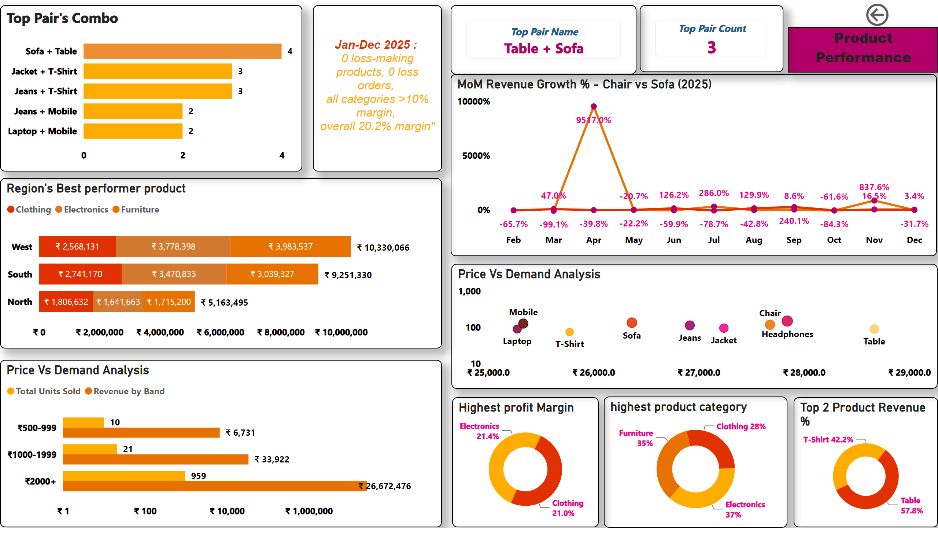
Product Performance-SQ2
Notes:
Top 2 Product Revenue %
No alt text provided
Region's Best performer product
No alt text provided
Highest profit Margin
No alt text provided
textbox
No alt text provided
Top Pair's Combo
No alt text provided
cardVisual
No alt text provided
cardVisual
No alt text provided
Price Vs Demand Analysis
No alt text provided
Price Vs Demand Analysis
No alt text provided
MoM Revenue Growth % - Chair vs Sofa (2025)
No alt text provided
listSlicer
No alt text provided
textSlicer
No alt text provided
Product Performance
No alt text provided
actionButton
No alt text provided
highest product category
No alt text provided

Slide 4
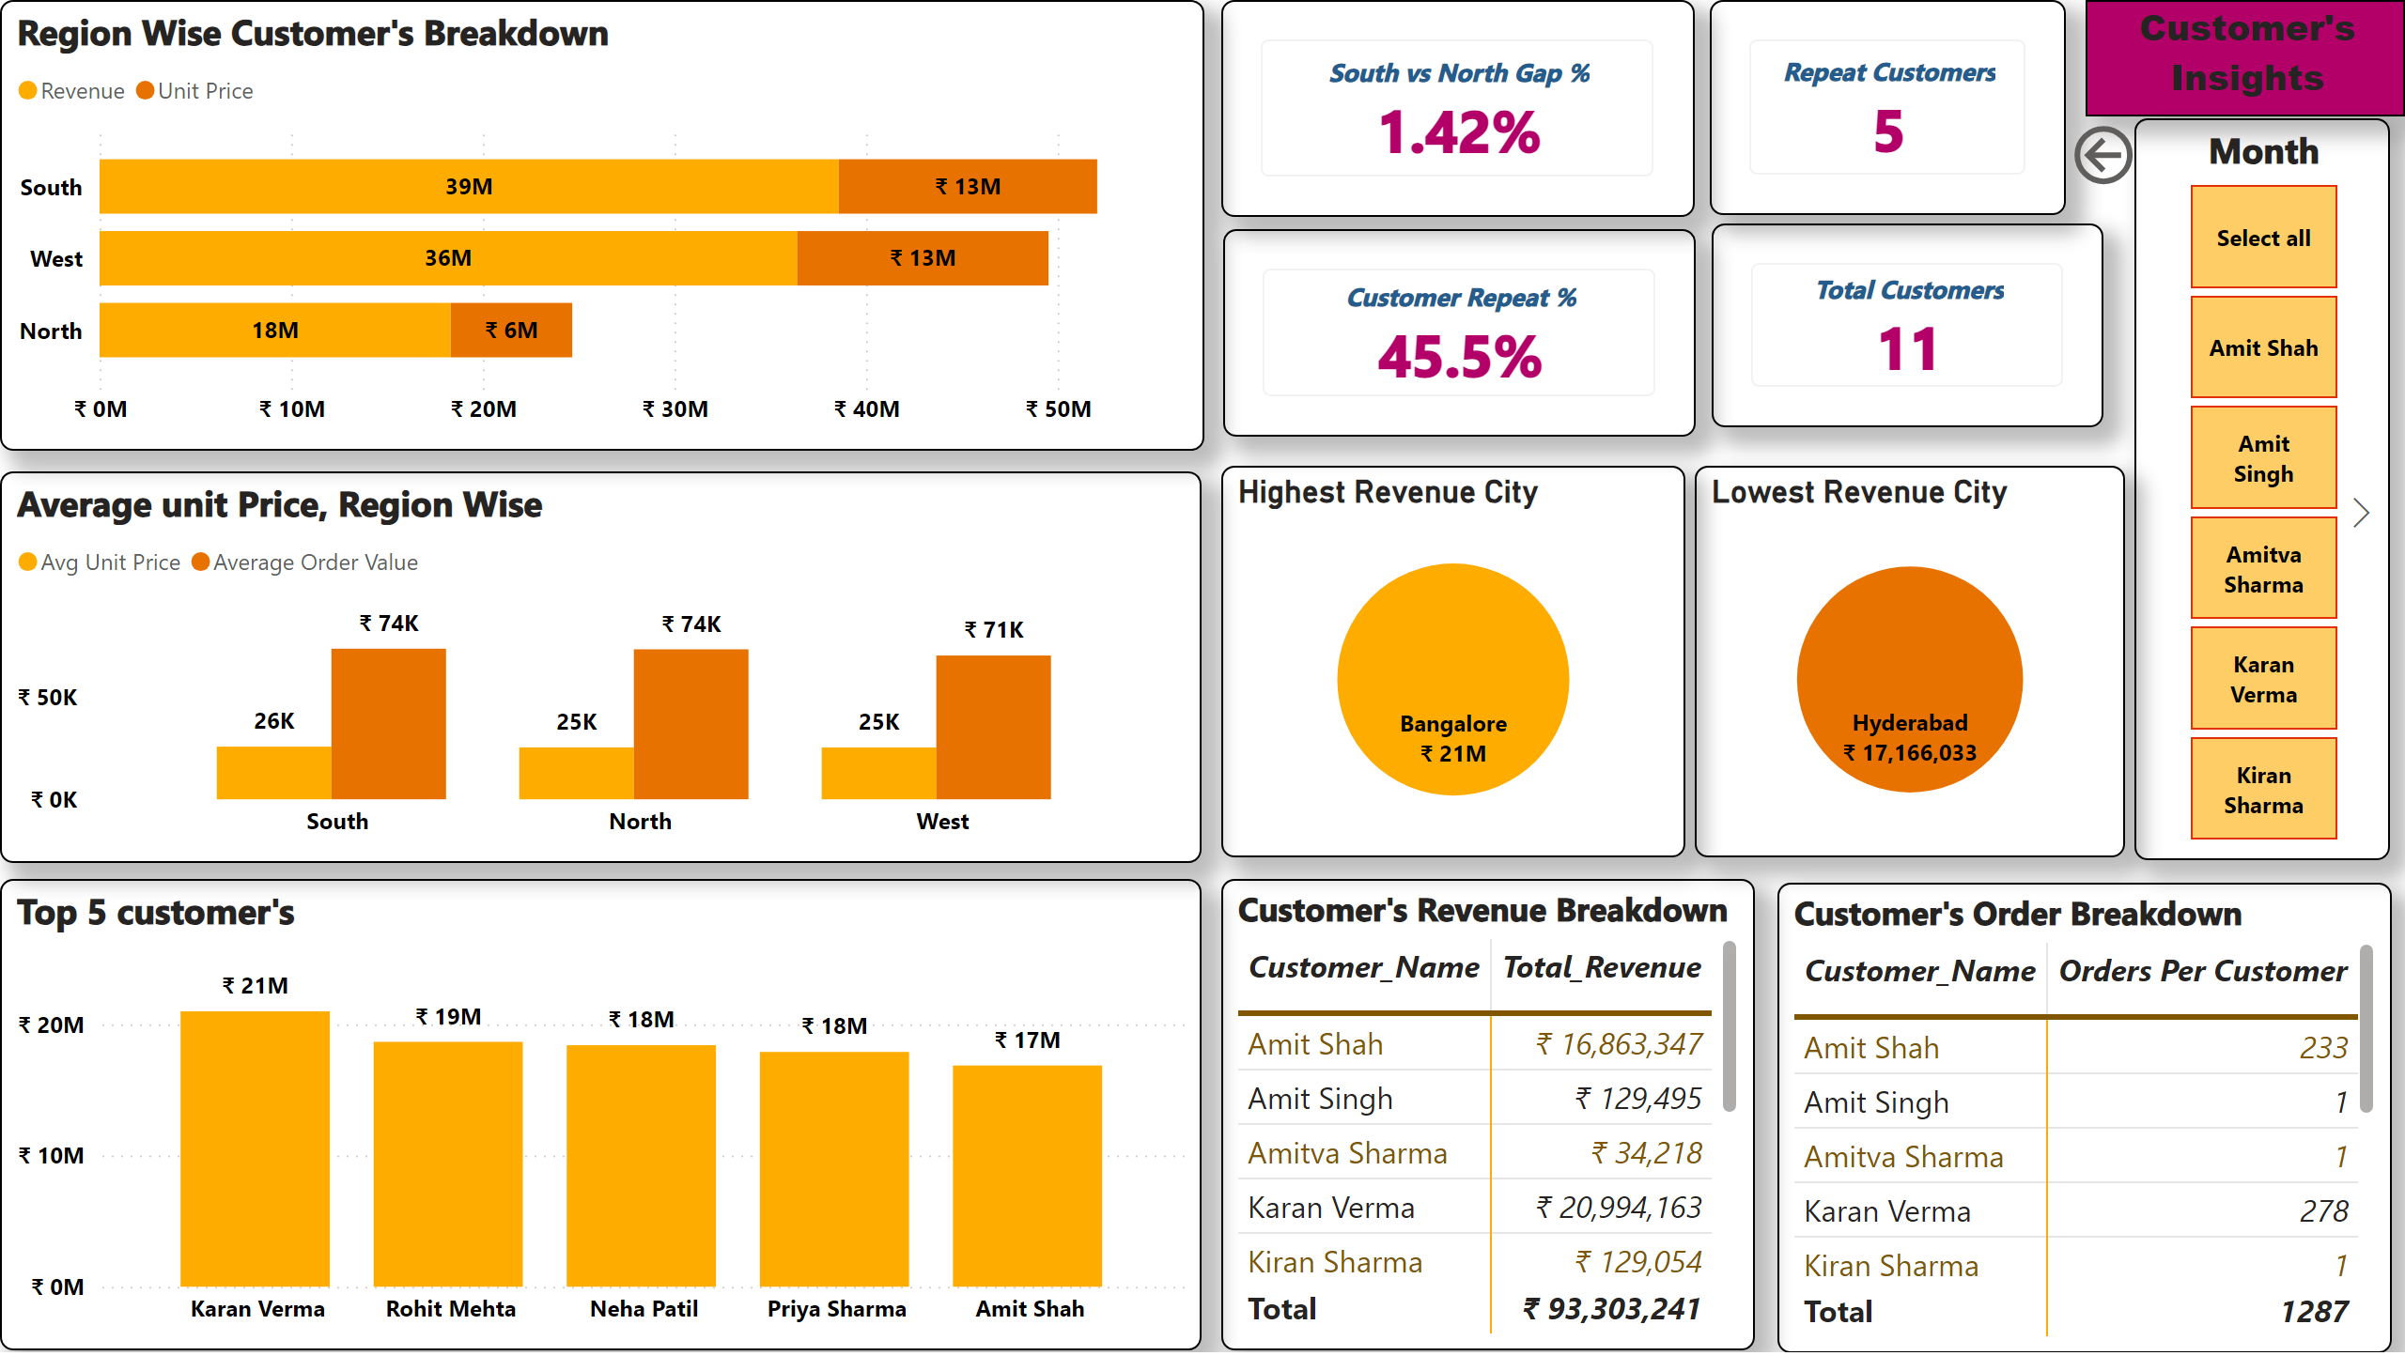
Customer's Insights-SQ3
Notes:
Highest Revenue City
No alt text provided
Lowest Revenue City
No alt text provided
Region Wise Customer's Breakdown
No alt text provided
Average unit Price, Region Wise
No alt text provided
cardVisual
No alt text provided
cardVisual
No alt text provided
cardVisual
No alt text provided
actionButton
No alt text provided
Customer's Insights
No alt text provided
cardVisual
No alt text provided
Top 5 customer's
No alt text provided
Customer's Revenue Breakdown
No alt text provided
Customer's Order Breakdown
No alt text provided
Month
No alt text provided
actionButton
No alt text provided

Slide 5
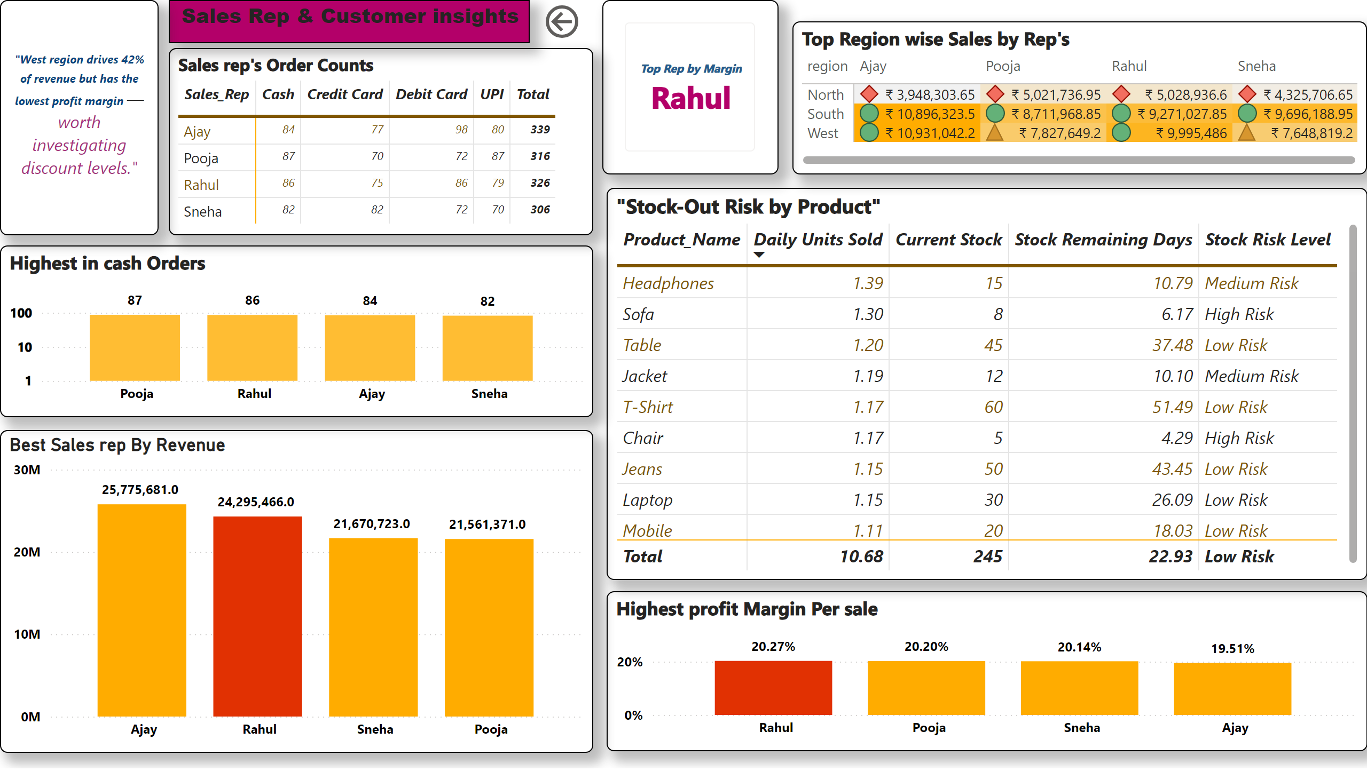
Sales Rep Performance-SQ4
Notes:
Highest profit Margin Per sale
No alt text provided
Top Region wise Sales by Rep's
No alt text provided
Sales rep's Order Counts
No alt text provided
"Stock-Out Risk by Product"
No alt text provided
cardVisual
No alt text provided
Highest in cash Orders
No alt text provided
Best Sales rep By Revenue
No alt text provided
actionButton
No alt text provided
Sales Rep & Customer insights
No alt text provided
textbox
No alt text provided

